Slide 1
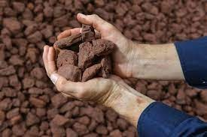
ESTIMATING THE PRESENCE OF IMPURITIES IN IRON ORE USING IBM WATSON MACHINE LEARNING
By
Tarun,
Sanjay,
Shashank.

Slide 2
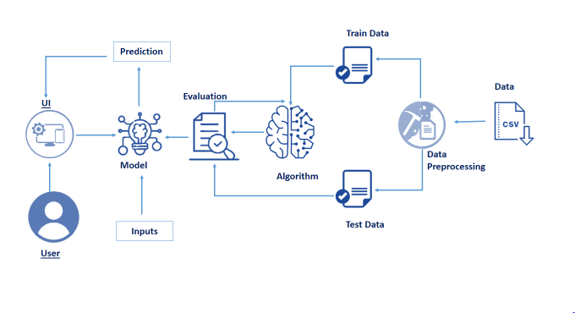

THE ARCHITECTURE

Slide 3
WHAT IS IMPURITY?
Any material that affects the purity of the material of interest
Impurities common in chemicals substances include small quantities of Lead, Arsenic, Iron, Chloride and Sulphate
Impurity means undesired particles
Impurities in the iron from the Blast Furnace include Carbon, Sulphur, phosphorus and silicon.
The most basic process is melting to remove impurities

Slide 4
STEPS TO PREDICT THE IMPURITIES USING ML MODEL
Collection of dataset
Data preprocessing
Model building
Application building

Slide 5
ABOUT THE DATA SET
ML depends heavily on data, without data, it is impossible for an “AI” to learn.
It is the most crucial aspect that makes algorithm training possible.
In Machine Learning projects, we need a training data set.
It is the actual data set used to train the model for performing various actions.
The more data we give for training the better will be the model.

Slide 6
INPUT DATA GIVEN :-
Average air flow
Average floating level
Percentile of iron feed
Amina flow
Ore pulp ph
Ore pulp density

Slide 7
THE PROCESS
The Model takes the input data and analyze it and gives the output.
Using the data set that we give, it processes the data.
It uses the some part of the data set to train the model and tests it with the remaining part and gives us the accuracy.
Based on the accuracy we can say that we can depend on the data or not.
…..Continued

Slide 8
Output of the model :-
Based on that it forms an algorithm .
When ever we give input data for prediction it takes that data and evaluates it with the help of algorithm it predicts the output.
This prediction is sent to the UI and displayed to the User
The below demo video gives you an overall idea about the project

Slide 9
PROJECT DEMO VIDEO

Slide 10
Thank You Have a Great Day
By
Tarun,
Sanjay,
Shashank.

